Slide 1
Presented to XYZ Corporation
June 1, 2022
Notes:
I can create different graphic backgrounds for use by various divisions, or for particular clients, as needed.

Slide 2
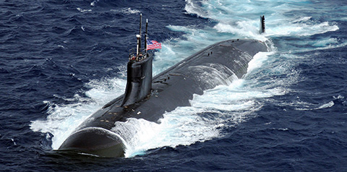

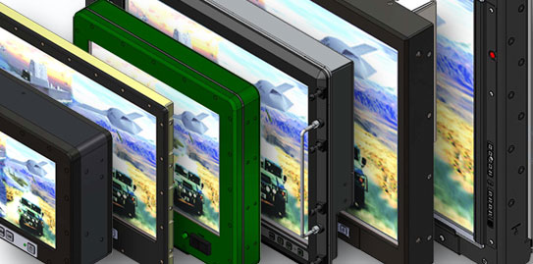
Your Title Here
Sample Bullet List
Fleet Sustainment
Professional Services
C5ISR
Another List Item

Slide 3


Epsilon Systems – A Trusted Partner
Diverse Professional and Technical Services Company
Founded in 1998
Consistent Organic Growth
Targeted Technology Acquisitions
Nearly 1,200 Skilled Professionals
Scientists/Engineers
Technical Specialists
Skilled Craftsmen

Slide 4
The Following Slides…
Section titles for each capability group
When adding slides, please select a “Layout” from Epsilon Template 1 and use the built-in formatting
Closing slide
Keep or delete as needed

Slide 5
Fleet Sustainment

Slide 6
Products & Services for C5ISR

Slide 7
Advanced Products
7

Slide 8
Enterprise Solutions and Professional Services
8

Slide 9
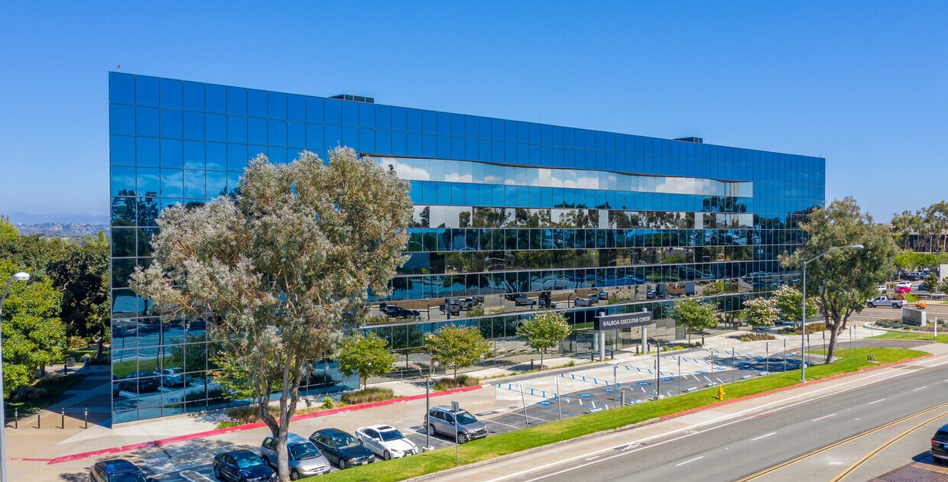
Why Epsilon Systems?
Proven Performance
Experienced and capable professionals with a clear focus on customer success
Responsive
Reliable, flexible and ready when called
Quality
Approved/certified quality management systems
Integrity
A values-based company

Slide 10
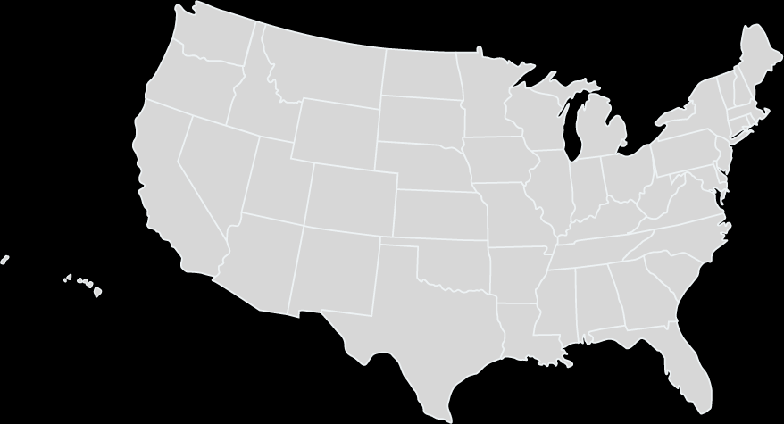
Epsilon Systems Office Locations
Philadelphia, PA
Dayton, OH
Warrenton, VA
Chesapeake, VA
Portsmouth, VA
Ridgecrest, CA
Headquarters: San Diego, CA
National City, CA
North Charleston, SC
Pearl City, HI
Las Cruces, NM
Jacksonville, FL
Largo, FL

Slide 11
Epsilon Systems Locations
PENNSYLVANIA
OHIO
CALIFORNIA
VIRGINIA
HAWAII
NEW MEXICO
SOUTH CAROLINA
FLORIDA

Slide 12

Questions?
Thank You
Contact Name, Epsilon Systems Title
Direct Phone Number
email@epsilonsystems.com

